Slide 1
EM algorithm reading group
What is it?
When would you use it?
Why does it work?
How do you implement it?
Where does it stand in relation to other methods?
Introduction & Motivation
Theory
Practical
Comparison with other methods

Slide 2
Expectation Maximization (EM)
Iterative method for parameter estimation where you have missing data
Has two steps: Expectation (E) and Maximization (M)
Applicable to a wide range of problems
Old idea (late 50’s) but formalized by Dempster, Laird and Rubin in 1977
Subject of much investigation. See McLachlan & Krishnan book 1997.

Slide 3
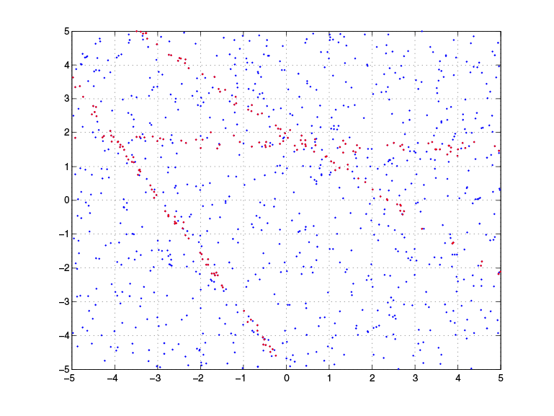
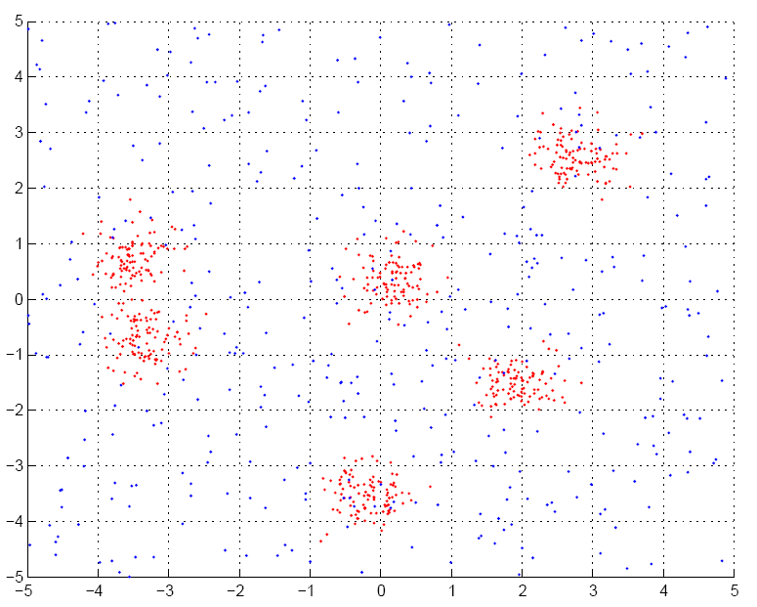
Applications of EM (1)
Fitting mixture models

Slide 4
Applications of EM (2)
Probabilistic Latent Semantic Analysis (pLSA)
  Technique from text community
P(w,d)
P(w|z)
P(z|d)
Z
W
W
D
D
Z

Slide 5
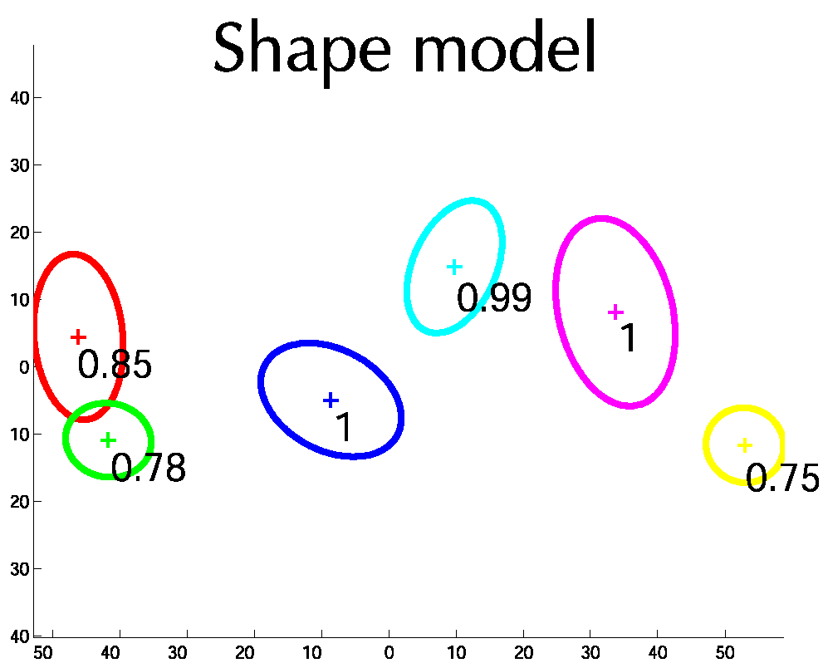
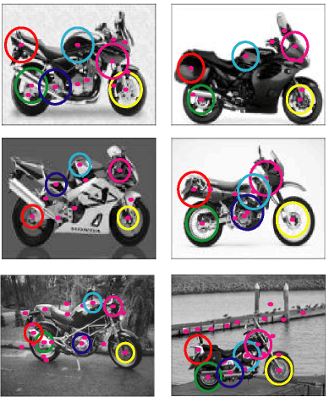
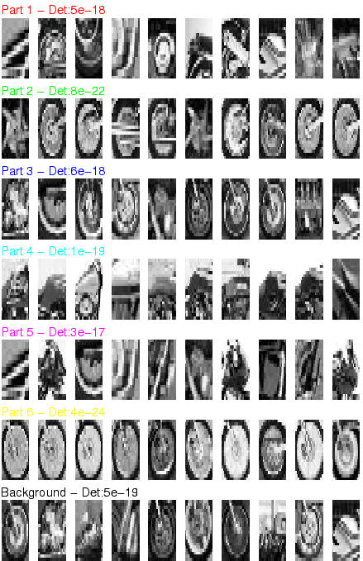
Applications of EM (3)
Learning parts and structure models

Slide 6
Applications of EM (4)
Automatic segmentation of layers in video
http://www.psi.toronto.edu/images/figures/cutouts_vid.gif

Slide 7

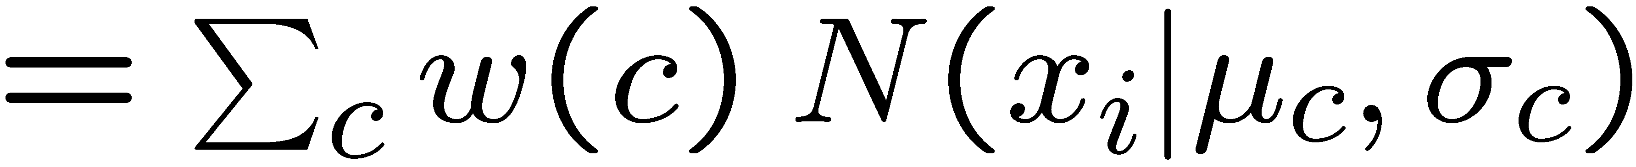
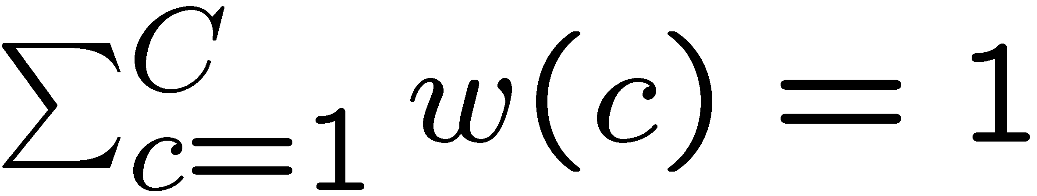
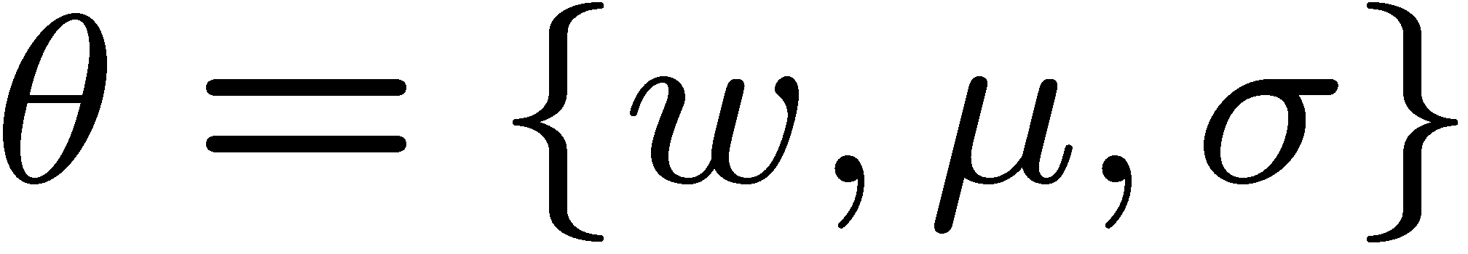


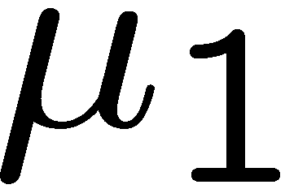
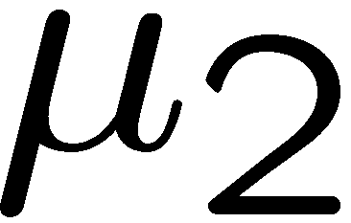
Motivating example
Data:
-4
-3
-2
-1
0
1
2
3
4
5
OBJECTIVE: Fit mixture of Gaussian model with C=2 components
Model:
where
Parameters:
P(x|θ)
keep
fixed
i.e. only estimate
x

Slide 8
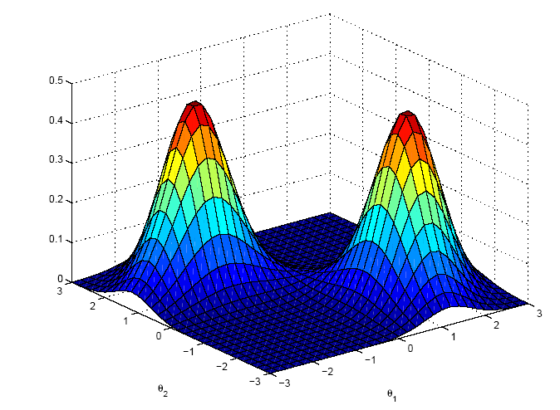
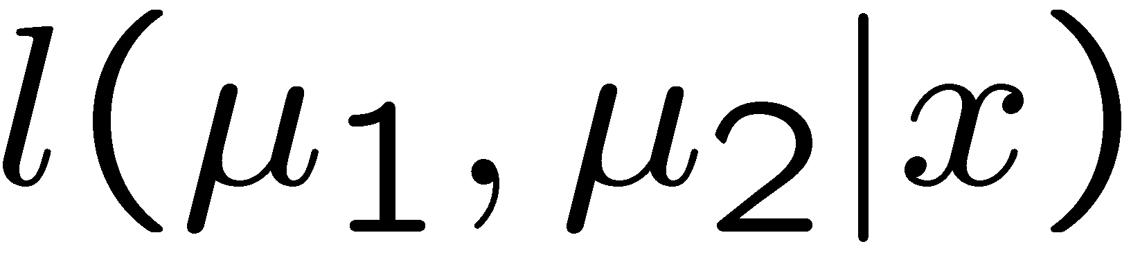
Likelihood function
Likelihood is a function of parameters, θ
Probability is a function of r.v. x
DIFFERENT FROM LAST PLOT

Slide 9
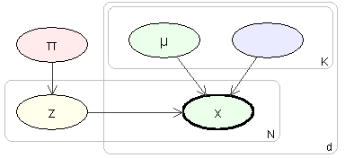
Probabilistic model
Imagine model generating data
Need to introduce label, z, for each data point
Label is called a latent variable
also called hidden, unobserved, missing
σ
c
-4
-3
-2
-1
0
1
2
3
4
5
Simplifies the problem:
if we knew the labels, we can decouple the components as estimate parameters separately for each one

Slide 10
Intuition of EM
E-step: Compute a distribution on the labels of the points, using current parameters
M-step: Update parameters using current guess of label distribution.
E
M
E
M
E

Slide 11
Theory

Slide 12
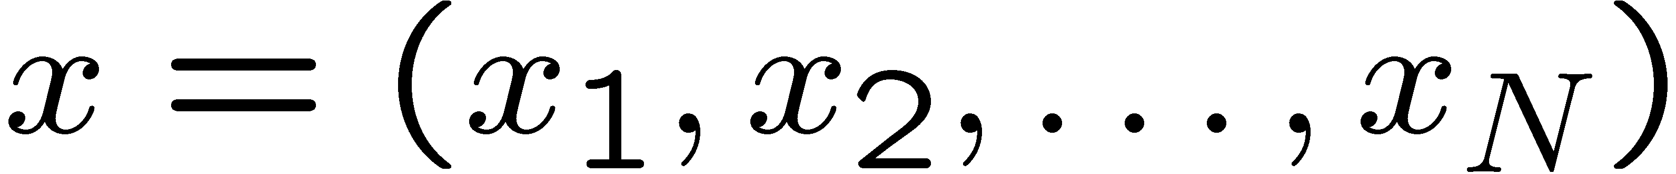
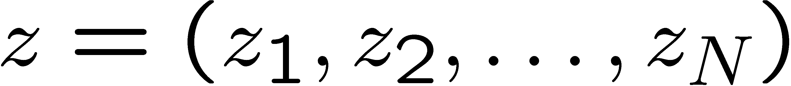

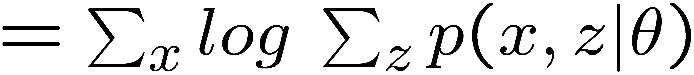
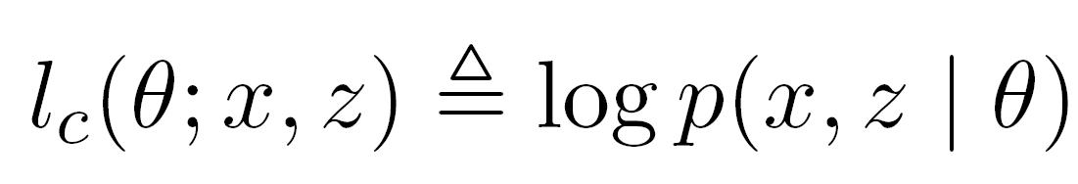
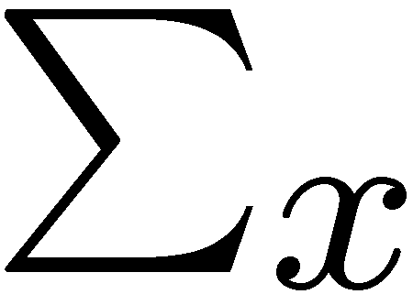
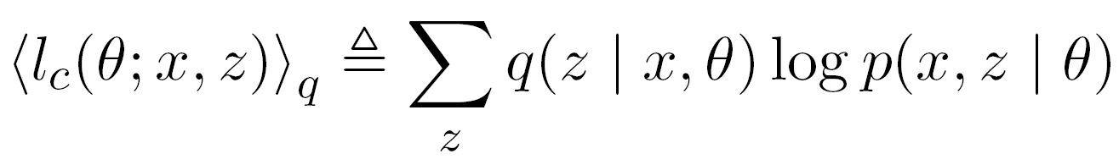
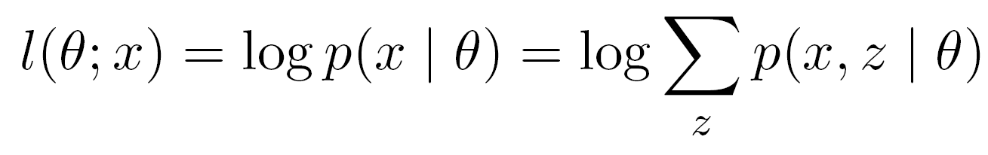
Some definitions
Observed data
Continuous I.I.D
Latent variables
Discrete 1 ... C
Iteration index
Log-likelihood [Incomplete log-likelihood (ILL)]
Complete log-likelihood (CLL)
Expected complete log-likelihood (ECLL)

Slide 13
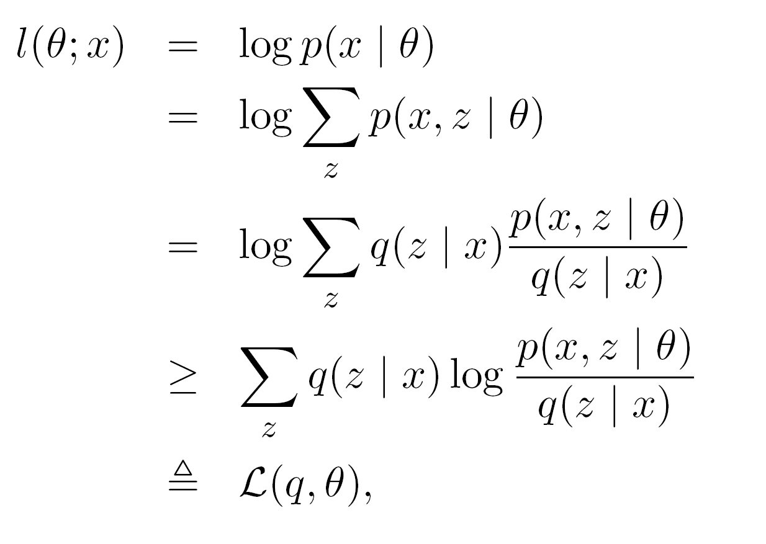
Lower bound on log-likelihood
Use Jensen’s
inequality
AUXILIARY FUNCTION

Slide 14
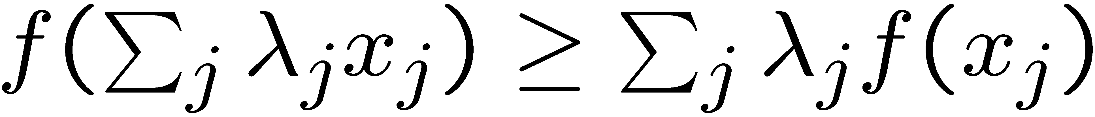
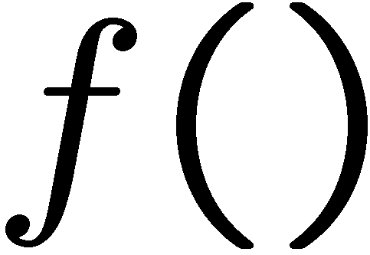
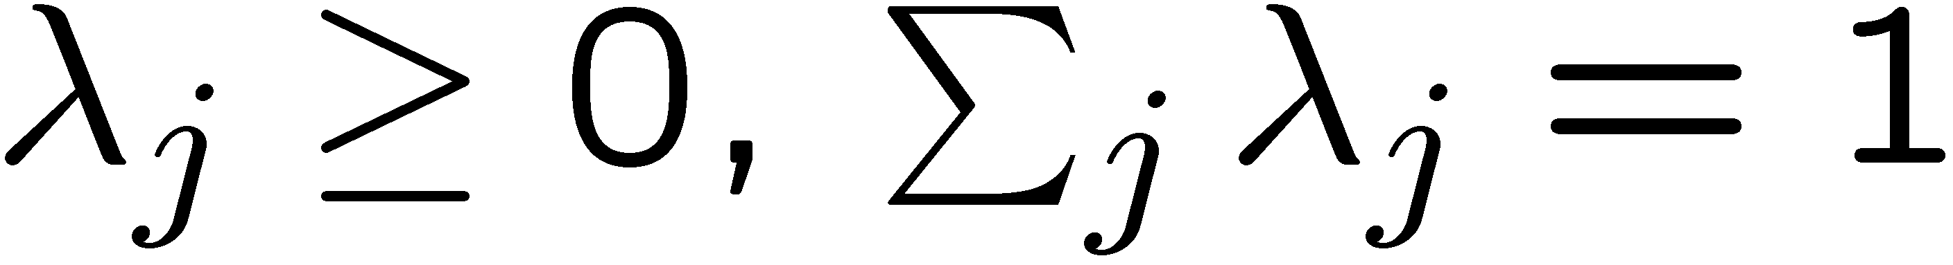
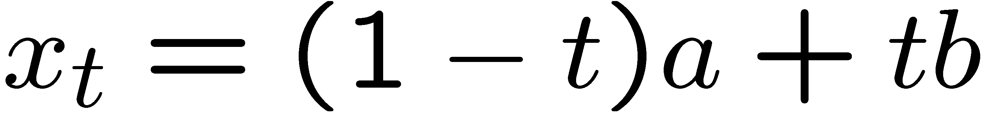

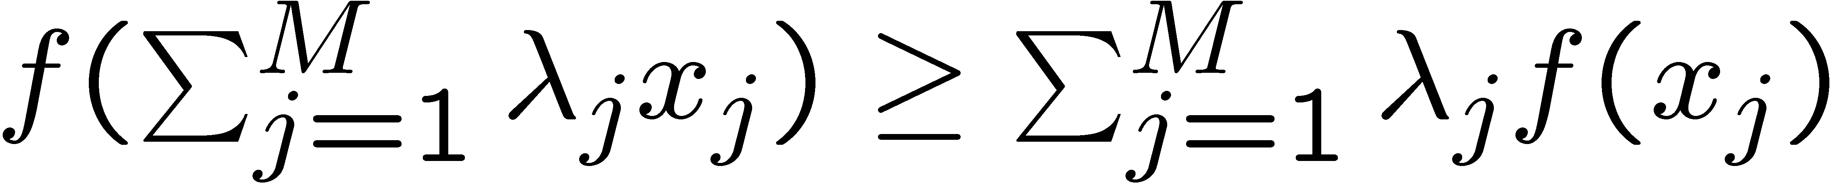
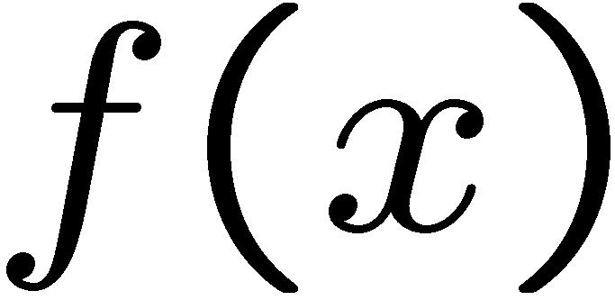




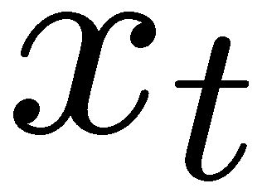
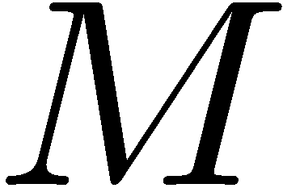
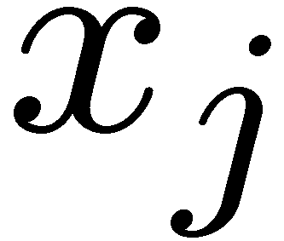
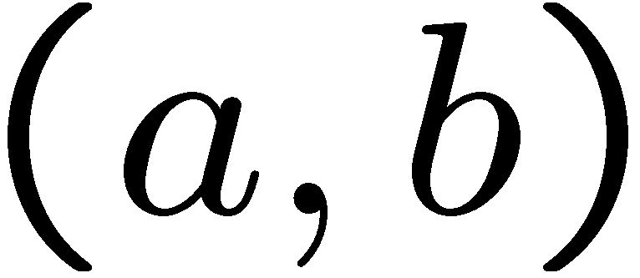
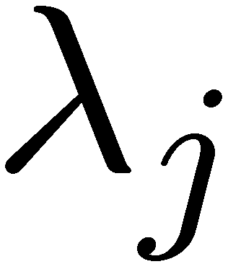
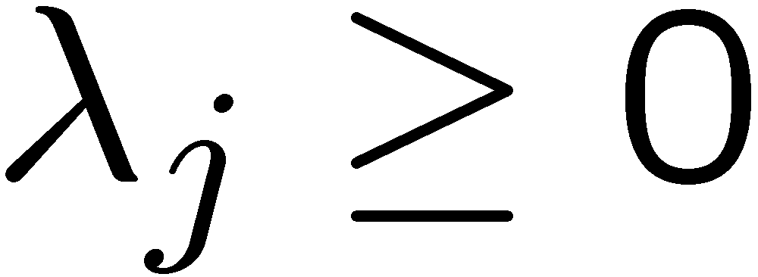
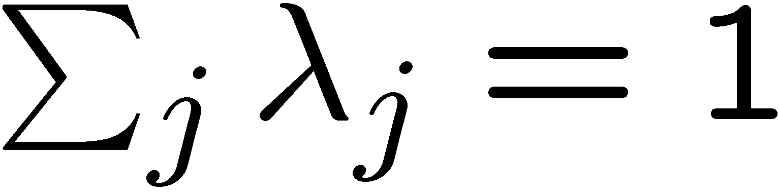
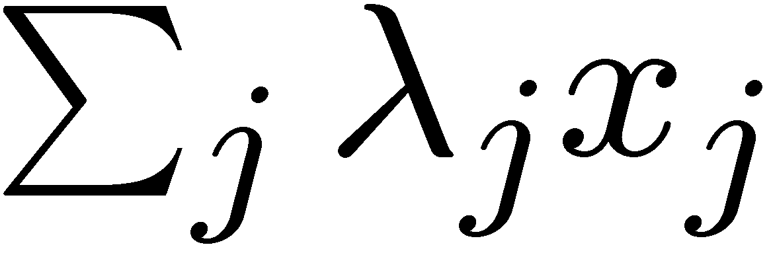
Jensen’s Inequality
Jensen’s inequality:
For a real continuous concave function
and
1. Definition of concavity. Consider
where
then
2. By induction:
for
Equality holds when all x are the same
2. Consider a set of points, , lying in the interval
and
such that
and
then
lies in

Slide 15
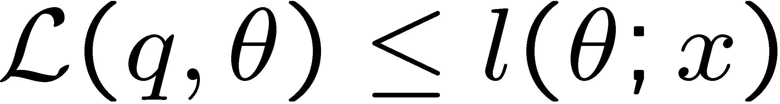
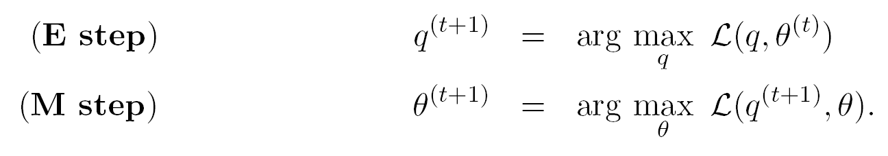
EM is alternating ascent
Recall key result : Auxiliary function is LOWER BOUND on likelihood
Alternately improve q then θ:
Is guaranteed to improve likelihood itself….

Slide 16
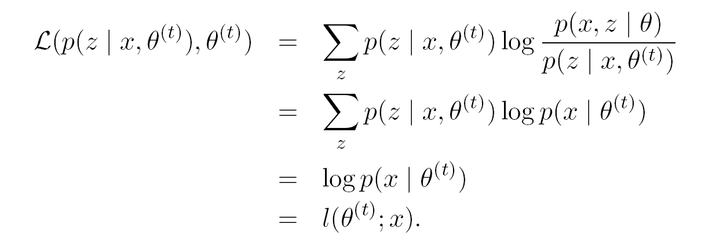
E-step: Choosing the optimal q(z|x,θ)
Turns out that q(z|x,θ) = p(z|x,θ^{t}) is the best.

Slide 17
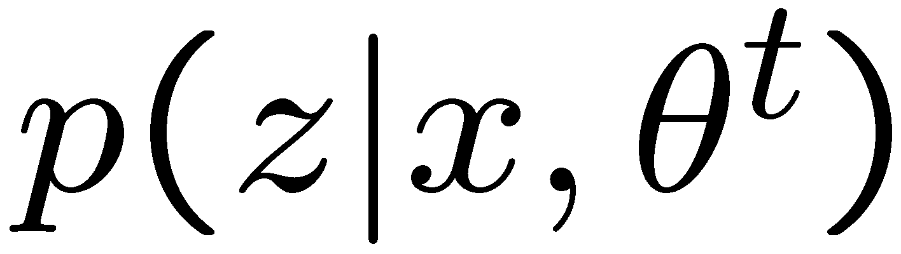


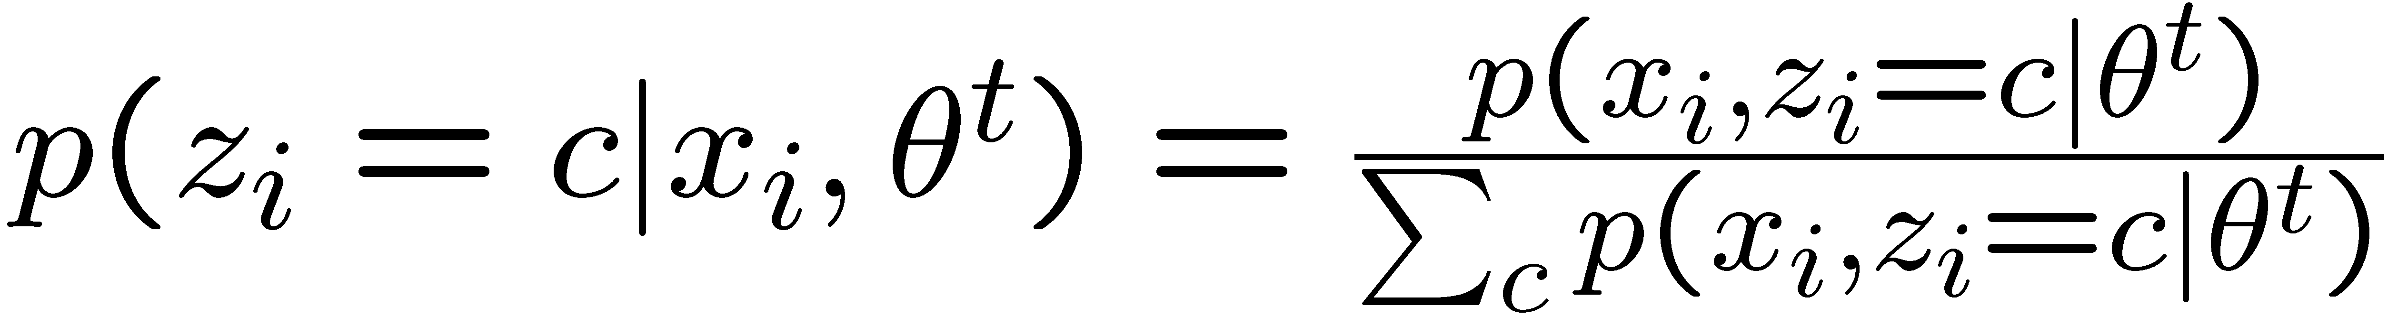
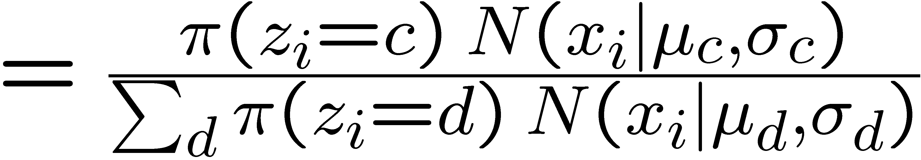
E-step: What do we actually compute?
Point 1
Point 2
Point 6
nComponents x nPoints matrix (columns sum to 1):
Component 1
Component 2
Responsibility of component for point :

Slide 18
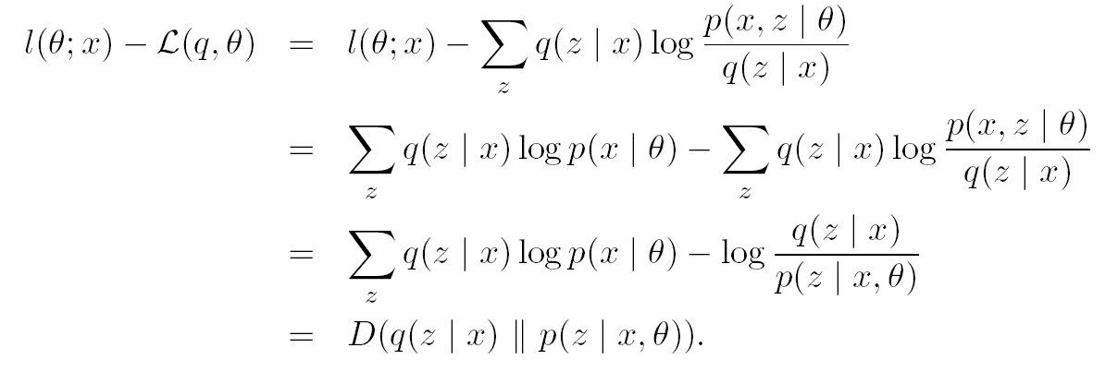
E-step: Alternative derivation

Slide 19
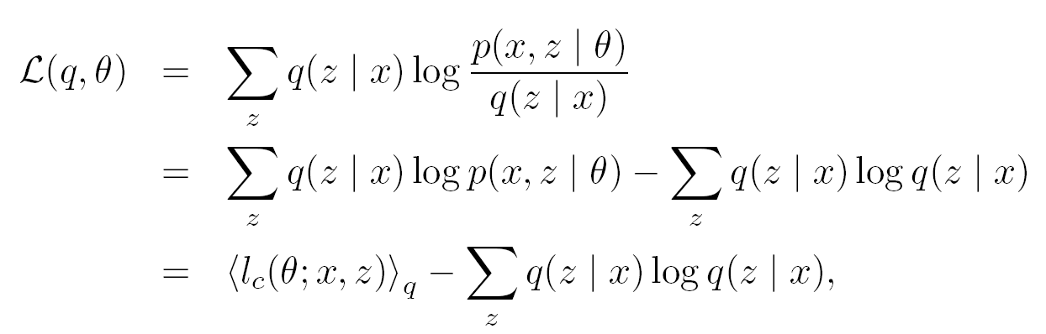
M-Step
Auxiliary function separates into ECLL and entropy term:
ECLL
Entropy term

Slide 20
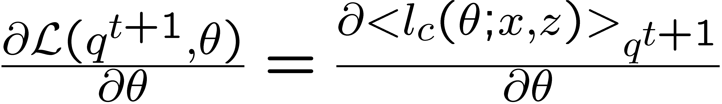
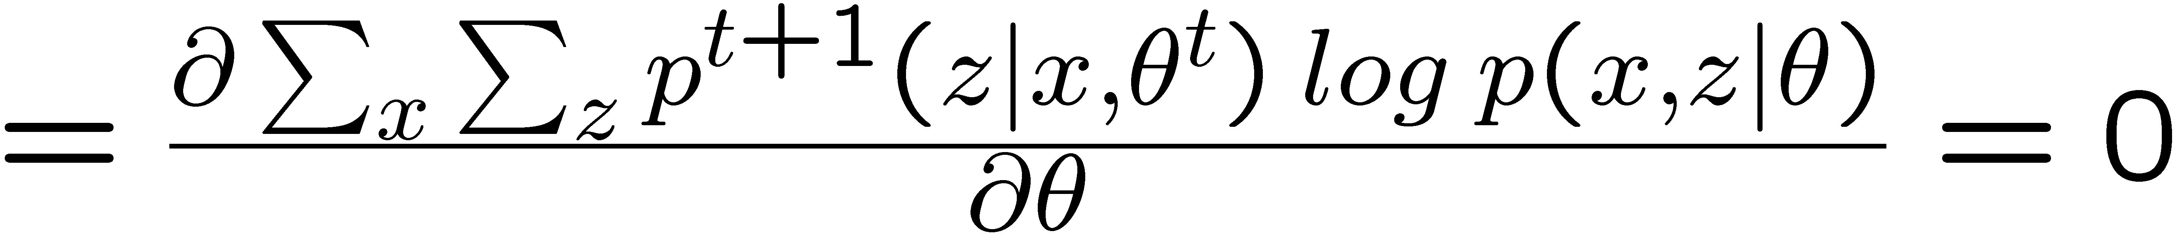

M-Step
Recall definition of ECLL:
From previous slide:
From E-step
Let’s see what happens for

Slide 21
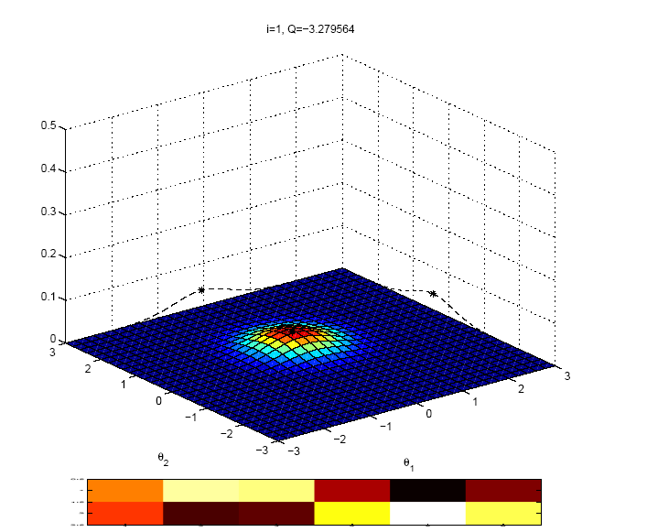

Slide 22
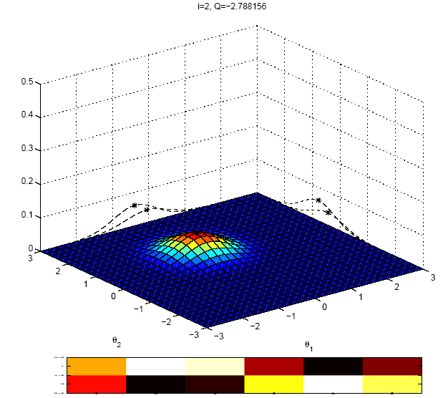

Slide 23
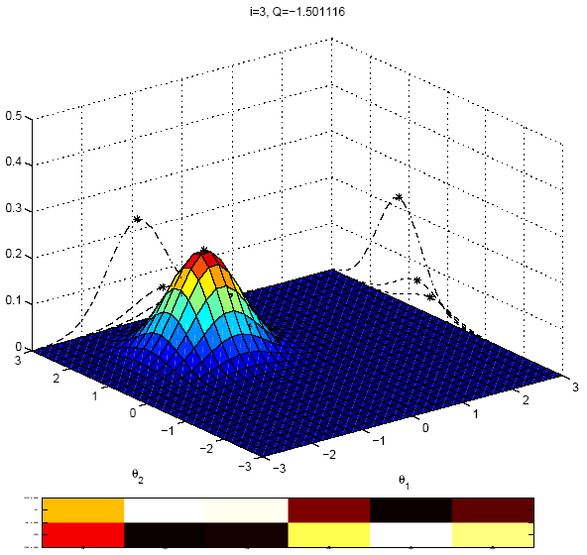

Slide 24
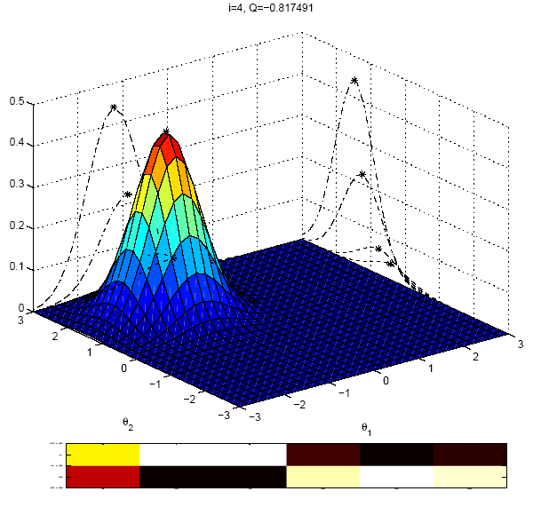

Slide 25
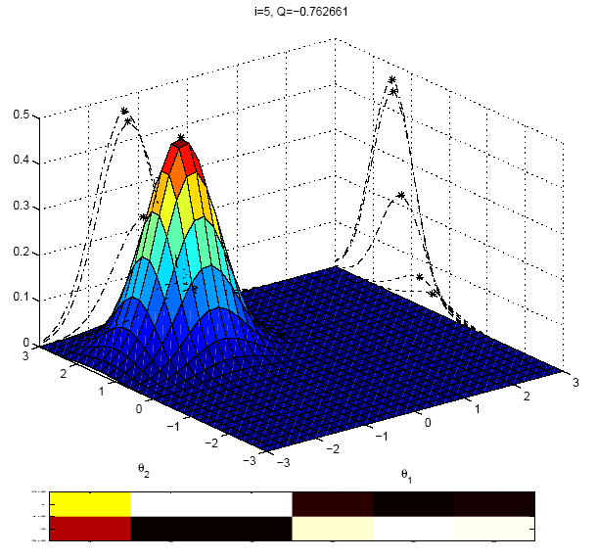

Slide 26
Practical

Slide 27
Practical issues
Initialization
Mean of data + random offset
K-Means
Termination
Max # iterations
log-likelihood change
parameter change
Convergence
Local maxima
Annealed methods (DAEM)
Birth/death process (SMEM)
Numerical issues
Inject noise in covariance matrix to prevent blowup
Single point gives infinite likelihood
Number of components
Open problem
Minimum description length
Bayesian approach

Slide 28

Local minima

Slide 29

Robustness of EM

Slide 30
What EM won’t do
Pick structure of model
# components
graph structure
Find global maximum
Always have nice closed-form updates
optimize within E/M step
Avoid computational problems
sampling methods for computing expectations

Slide 31
Comparison with other methods

Slide 32
Why not use standard optimization methods?
In favour of EM:
No step size
Works directly in parameter space model, thus parameter constraints are obeyed
Fits naturally into graphically model frame work
Supposedly faster

Slide 33

Gradient
Newton
EM

Slide 34

Gradient
Newton
EM

Slide 35
Acknowledgements
Shameless stealing of figures and equations and explanations from:
Frank Dellaert
Michael Jordan
Yair Weiss

